Slide 1
Ultimate Tic Tac Toe
Matt Gimbut and Mike Moscariello

Slide 2
About The problem
Each cell in the large board contains another small board
Total of 81 cells (9 small boards of 9 cells)
Player ‘X’ goes first and turns alternate

Slide 3
About The problem
The previous move dictates where the next move must be played
The first move can be played anywhere
Winning a game in a small board counts as a square won on the big board

Slide 4
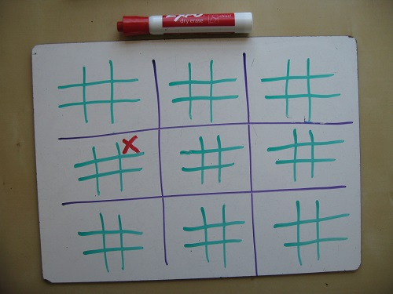
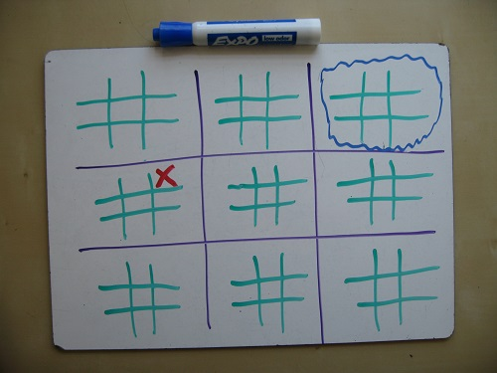
About The problem

Slide 5
About the problem
Players now have to solve multiple small puzzles to win the large puzzle
Players can also dictate where opponents can move
Players can cause opponent to waste a turn by making them play on a completed board

Slide 6
Our Approach
Started by completing minimax algorithm for a regular game of tic tac toe for the big board
Added another level of minimax to that to solve the small board
The two levels of the minimax algorithm work together to determine the best spot for the computer to play

Slide 7
Our approach
Computer tries to block player from winning in small boards first if possible
Moves to look at big boards after to find the best spot to win/prevent the player from winning

Slide 8
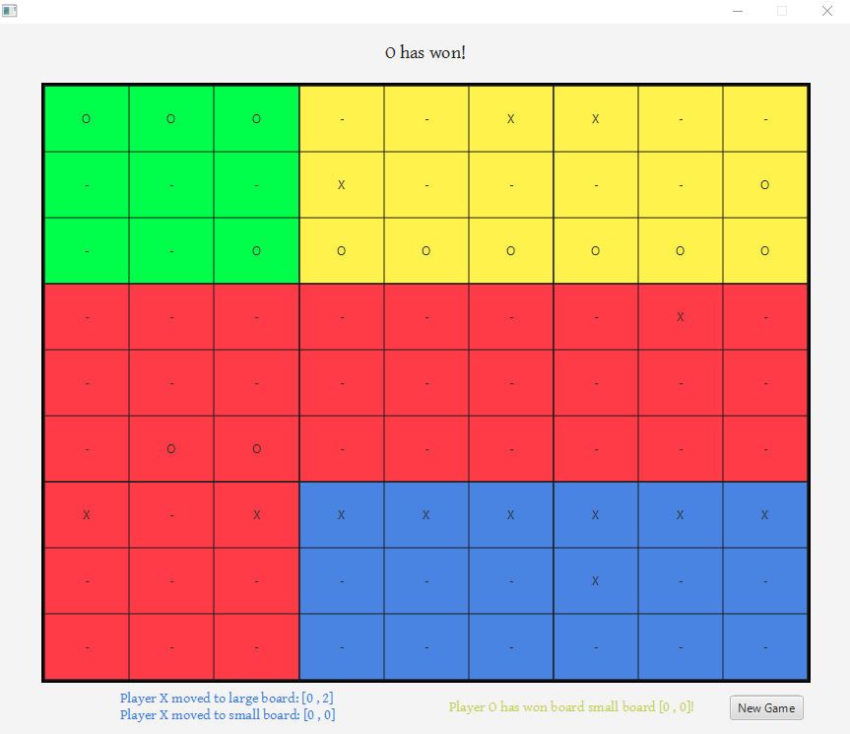
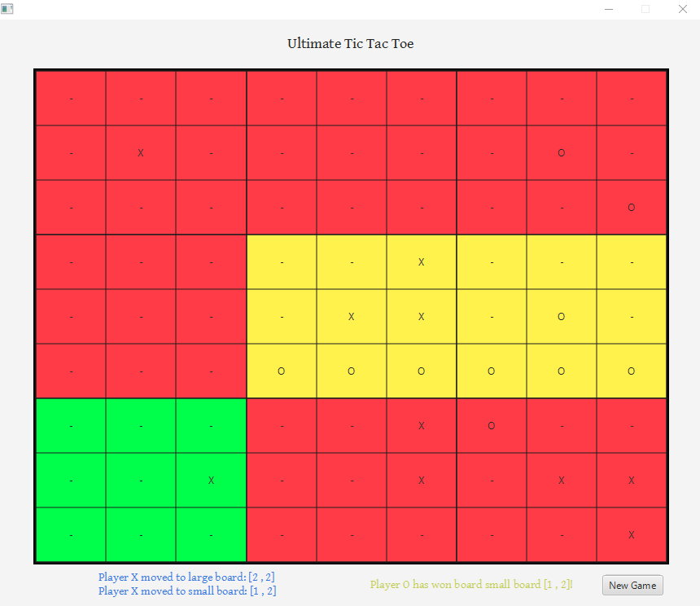
Final result
Created algorithm in Java
Created game application using JavaFX

Slide 9
difficulties
Because of the massive number of possibilities, brute force is impossible
Most common solution is minimax, which is not the best because of the lack of any simple heuristic function
Can be difficult to quantify positional advantage

Slide 10
What we learned

